Slide 1

The Shaw BroThers in Singapore
A firm that influenced leisure and popular culture.
GES1009: Week 7
Dr. Donna Brunero

Slide 2
Origins of Shaw Brothers
Shaw Brothers business in Singapore c. 1930s-1960s
Cinemas
Film production
New World and Great World

Slide 3
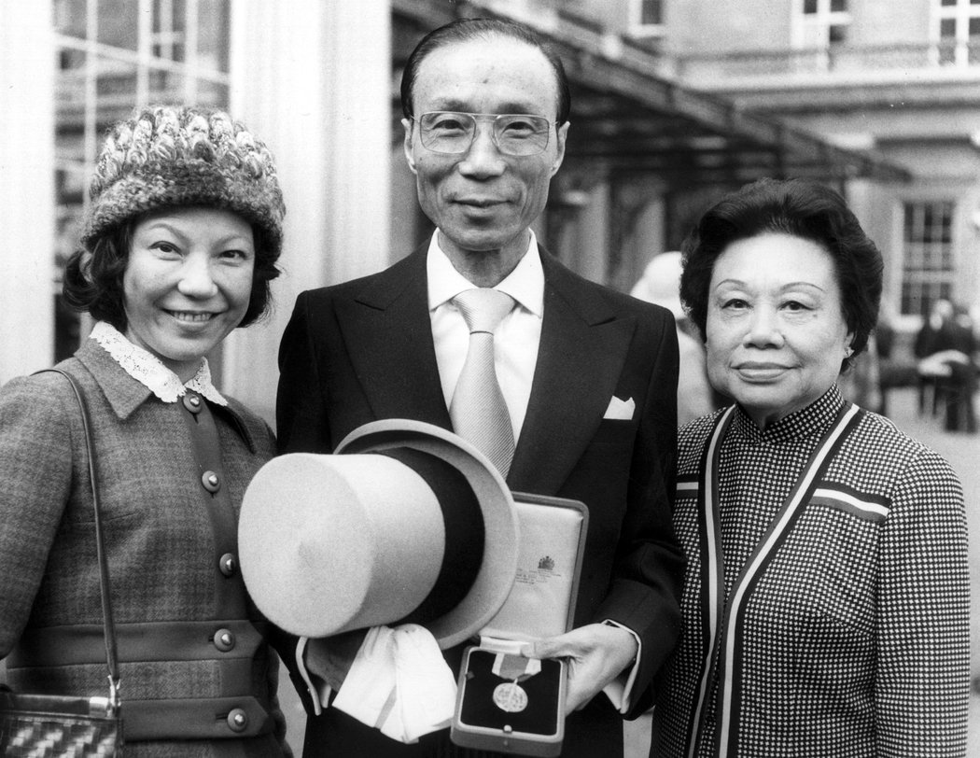
Run Run Shaw, with his daughter and wife.
Sons of a textile merchant, the eldest of four brothers created a film production company called Tianyi (unique) Film Company in Shanghai (1925). Runje, Runde, Runme and Run Run.
Producing classic tales, keeping actors and actresses on exclusive contracts.
Later Shaw films (produced in Hong Kong)would spark the craze for Wuxia or Kungfu movies.

Slide 4
Singapore
Runme moved to Singapore to supervise the distribution of films in Southeast Asia in 1926. Run Run joined him in 1927.
Shaw Brothers was formed in 1928.
Created a network of companies including cinemas/film production/amusement parks.
Family involvement ( sons joining the business)
Local employees brought into management positions.
Partnerships
A firm that defined leisure in Singapore!

Slide 5
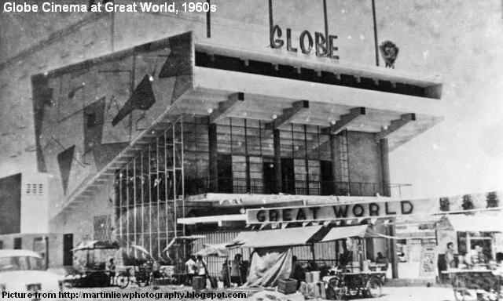
Cinemas
By the late 1930s, Shaw Brothers had more than 130 cinemas in Southeast Asia.
Some bought or built, others in partnership
1938- established Malayan Theatres (Pte Ltd) to manage all cinemas
Pavillion, Roxy, Grand, Globe cinemas…
Films: English, Malay, Chinese dialect, Mandarin (later), Tamil.

Slide 6
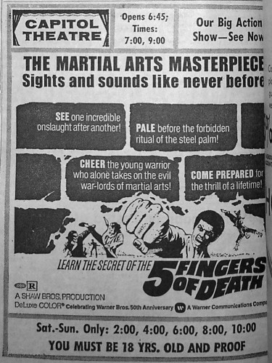
Strategies for Success: Making Cinema accessible
First run: blockbusters. Higher prices, the ‘best theatres’
Second run: cheaper tickets, older films (or reruns), basic seating
By 1960s: dual purpose cinemas…
Live shows AND the cinema.
Investing in new technologies – 3D cinemas, new projectors.

Slide 7
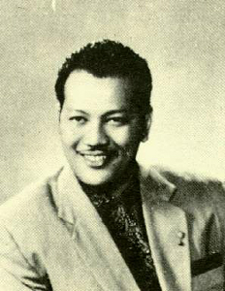
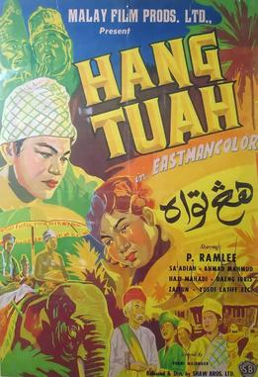
Film Production
In Singapore the production studio was in Jalan Ampas.
A gold age of Malay films
tapped into the local demand and interest. Themes? Married life, urban life, migration.
Hanchor Hati (Broken Heart) a big success.
Shaw film production discovered a rare talent in a young singer: P. Ramlee
P. Ramlee emerged as the ’King of Malayan film’.

Slide 8
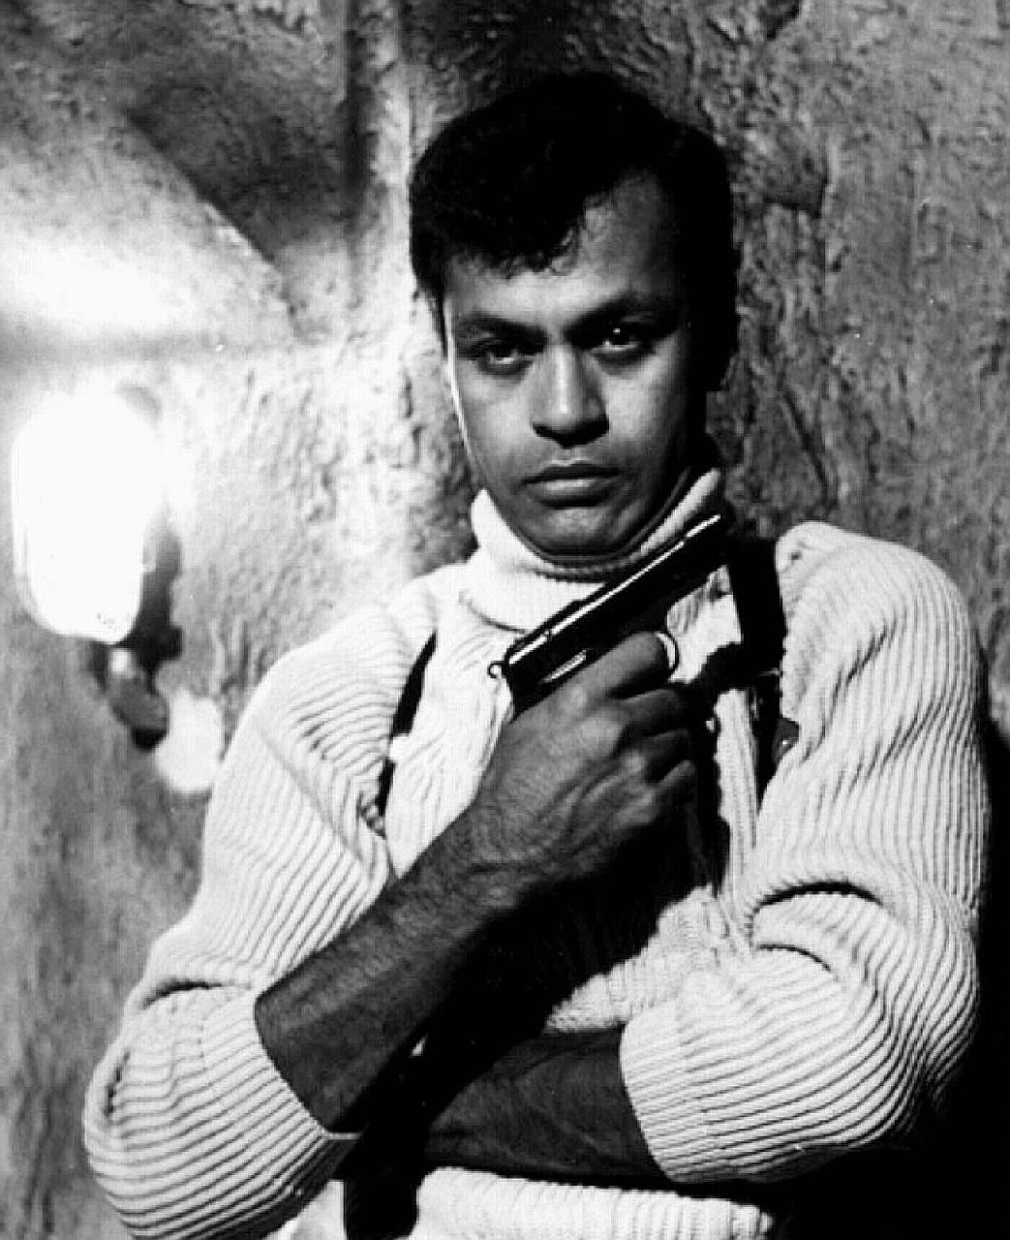
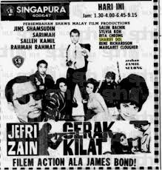
Creating Singapore’s James Bond…

Slide 9
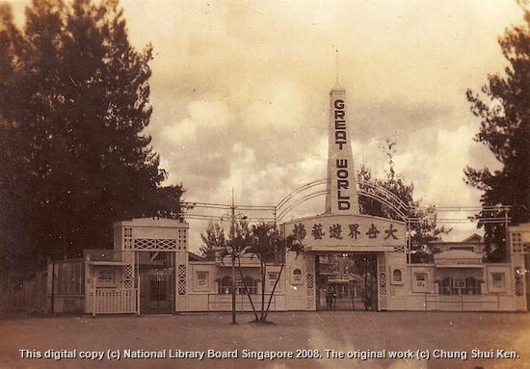
Amusement Parks: New World and Great World
New World- at Jalan Besar
Great World – at Kim Seng Road
Fun fairs, hawker stalls, rides, cabaret shows, theatres. (Cabaret shows become the most popular feature).
Many families would visit these amusement parks once a week.

Slide 10
POST WAR
War years? Business severely curtailed. The Shaw Bros are forced to work for the Japanese and to screen propaganda films.
Post 1945: Rebuilding many theatres. The firm continued to manage theatres and the two amusement parks. (By 1960 more than 100 cinemas across Southeast Asia)
Separation of Singapore and Malay meant that Malaysian film relocated.
Film production in Singapore ceased in 1967 (Shaw business in Hong Kong continued to produce popular films, and invested in television).
Amusement parks began to lose their appeal.

Slide 11
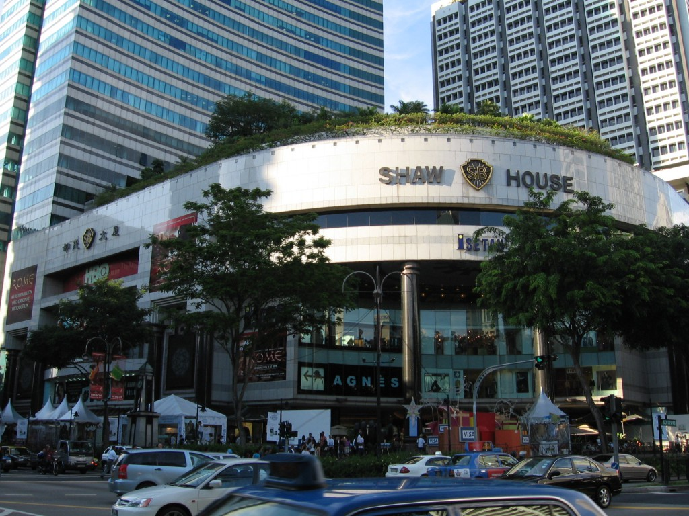
Shaw Organisation
Registered in 1988.
Encompassed property, finance, entertainment and management interests.
A key holding: Shaw House on Orchard Road
Success of the multiplexes as a new means to delivering more films to a wider audience.

Slide 12
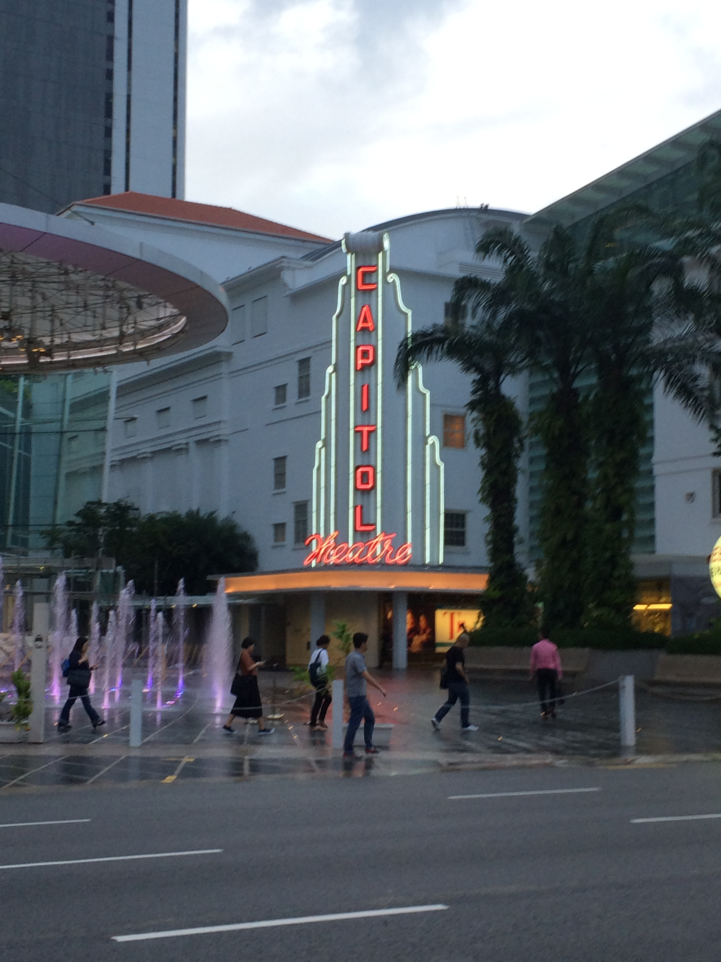
Concluding thoughts:
A family firm with interests in Hong Kong, Singapore and Malaysia
Singapore was a centre for Shaw Bros operations in Southeast Asia.
The business demonstrated innovation, local adaptations and became synonymous with local lifestyles and leisure
The popular culture influence of this firm can still be felt today.

Slide 13
Further Reading:
Shaw’s history: http://www.shaw.sg
T. Barnard, “Film Melayu: Nationalism, Modernity and Film in a Pre-World War Two Malay Magazine” Journal of Southeast Asian Studies, Vol. 41, No. 1, Symposium on Malay PrintCulture (Feb., 2010)
For an interesting account of spy films in Asia: http://diedangerdiediekill.blogspot.sg/search/label/Singaporean%20cinema

